Slide 1
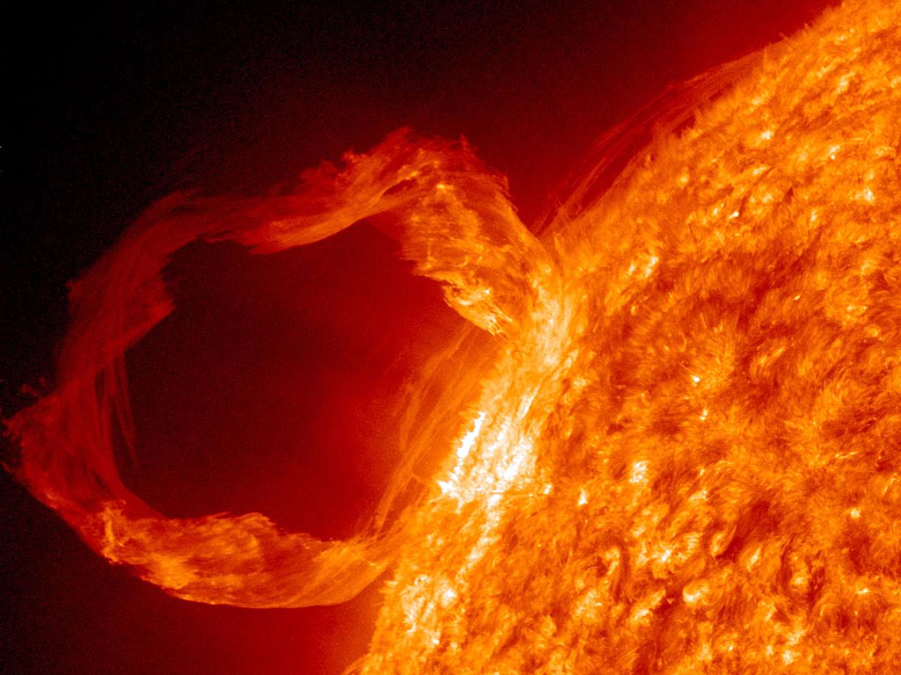
The back stage life of a
Space Weather Forecaster
By: Corey Koller

Slide 2
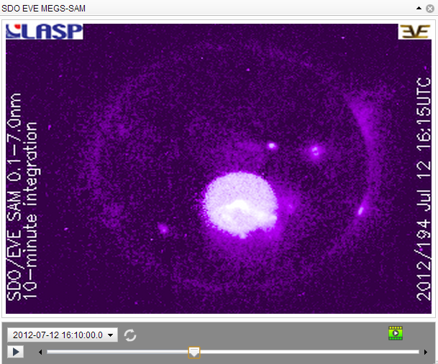
SDO EVE
2012-07-12T16:56Z – X1.4 class (S14 W02)

Slide 3
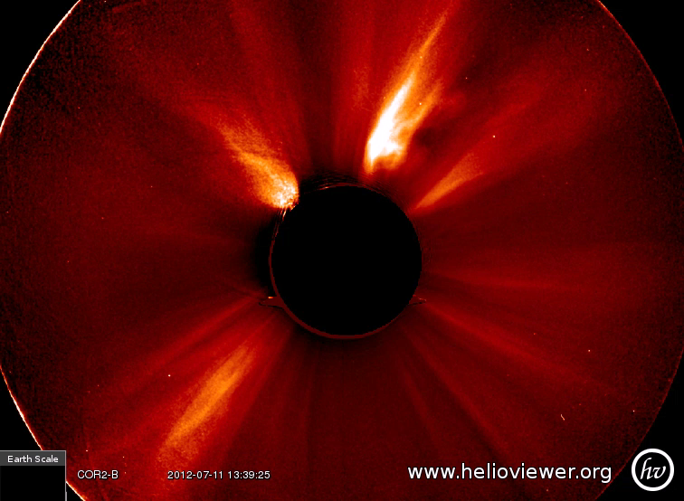
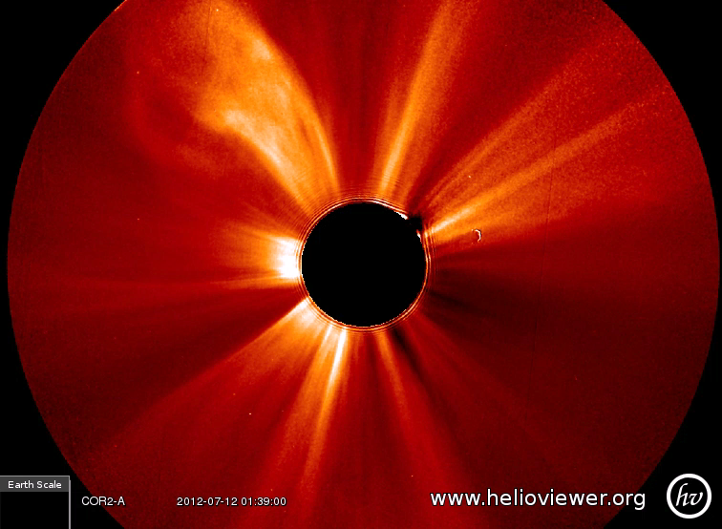
Coronagraphs:
STEREO B
STEREO A
Flare and CME are associated together, Flare occurred first.

Slide 4
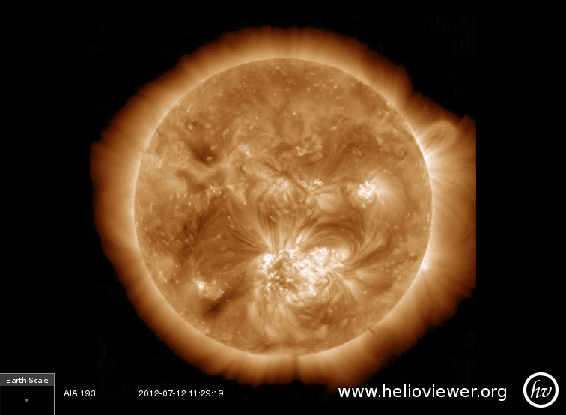
SDO AIA 193
Source Region

Slide 5
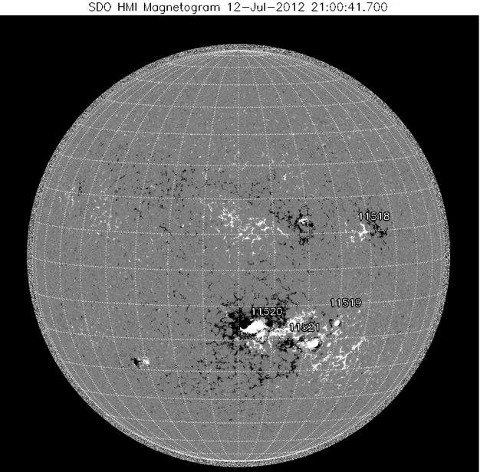
Solar Monitor: Active Source Regions
(11520)

Slide 6
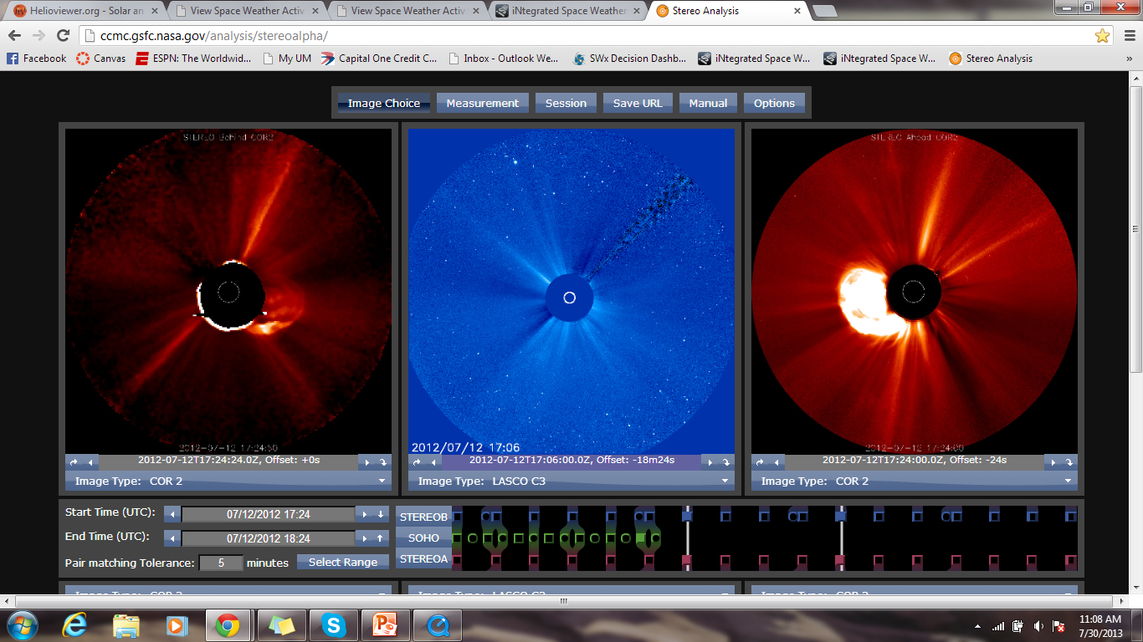
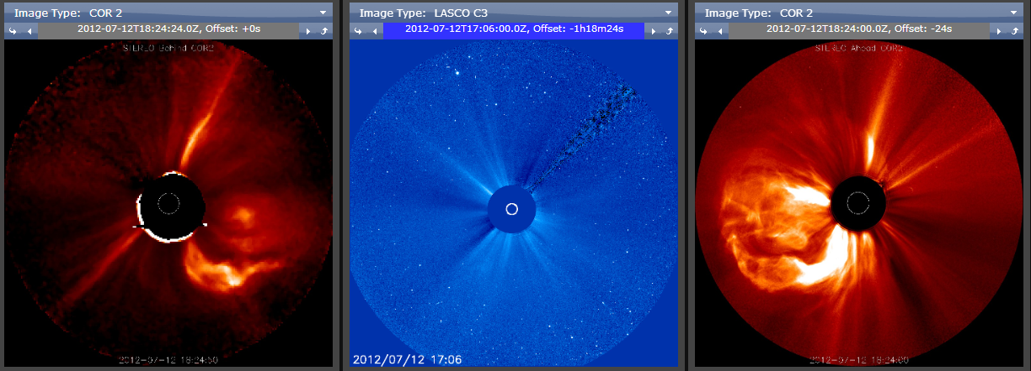

Slide 7
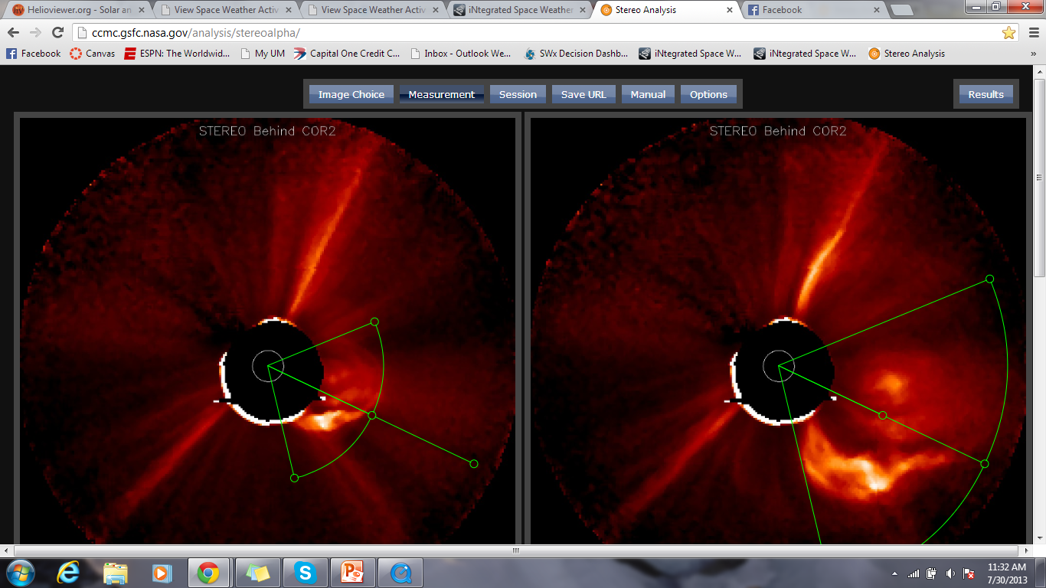
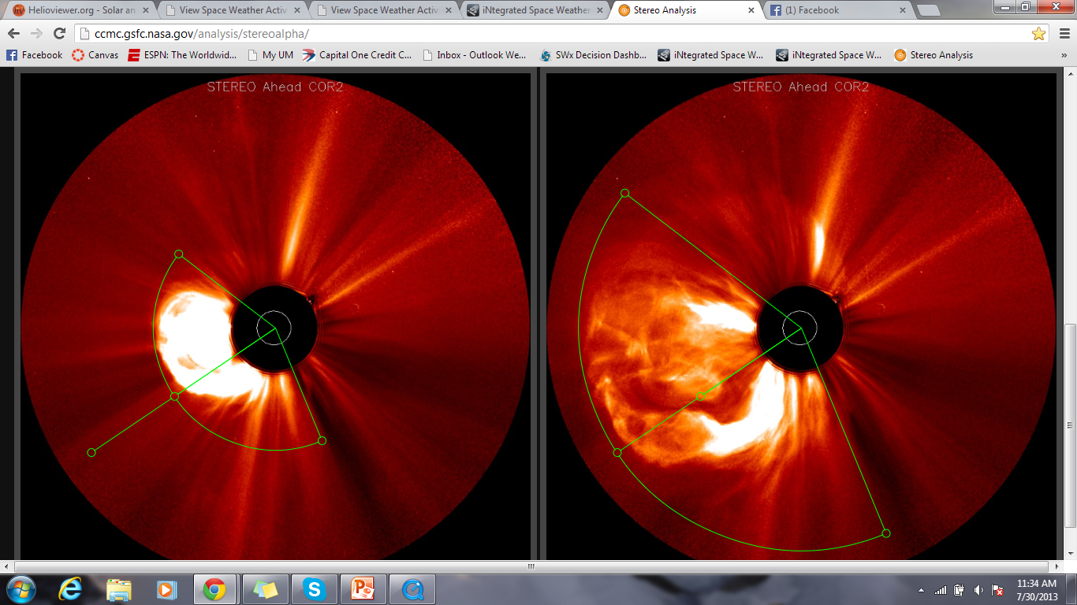

Slide 8
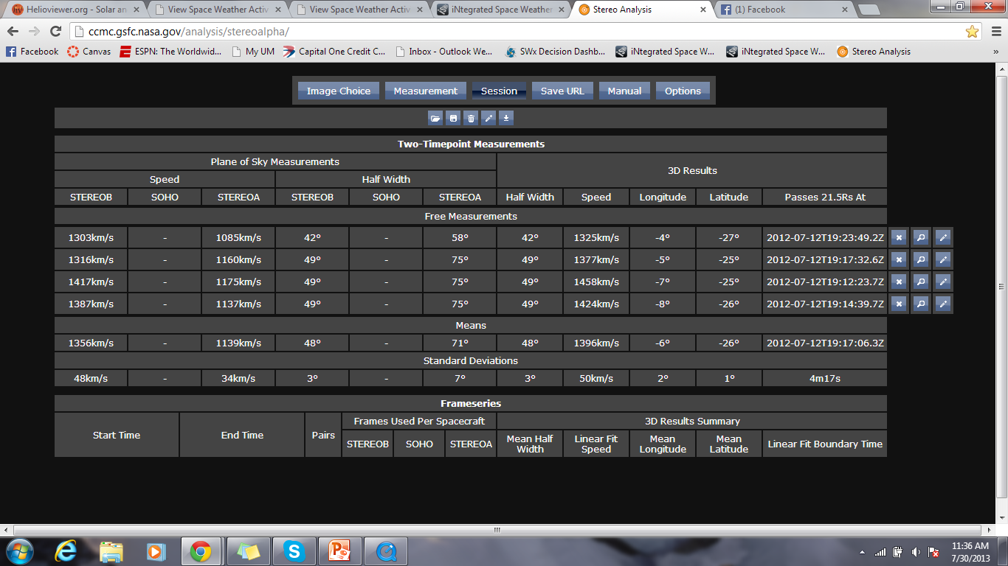
2012-07-12T16:54Z (STEREO B) ~ 1396 O -6/-26 48 STEREO A, B, and SOHO 2013-07-12T19:17Z

Slide 9
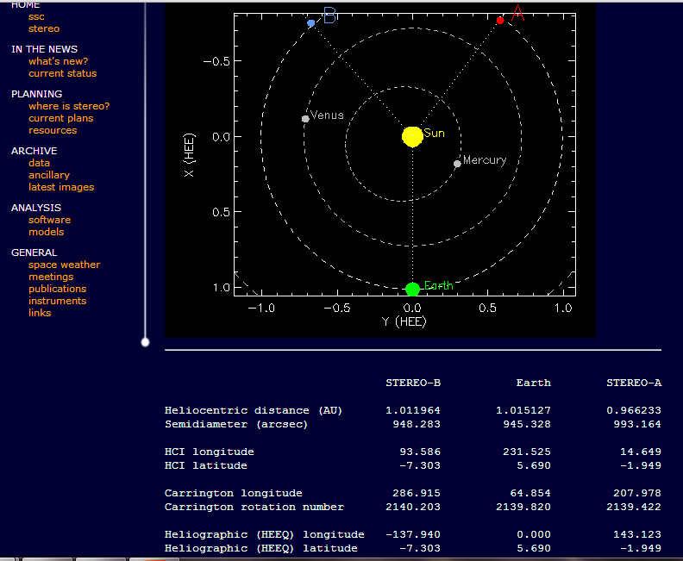
Where is STEREO?

Slide 10
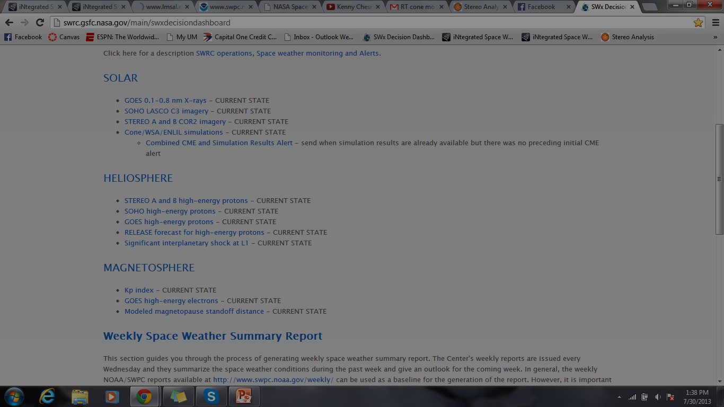
Send alerts based off parameters.

